Slide 1


poultry diseases fourth stage
Viral Diseases
Dr. Isam Azeez
Department of Pathology and Poultry Disease
College of Veterinary Medicine
university of Basrah

Slide 2
Viral Diseases
Newcastle Disease (ND)
Is the most common, the most widely prevalent, and economically the most important viral disease of poultry in our country.
- Caused by Avian paramyxovirus type 1 (APMV1)
- Virus spreads through the air and the Infection occurs mainly through inhalation or ingestion.
- The virus survives for several months.

Slide 3
(Forms of ND)
1 -Doyle’s , Asiatic form (Digestive form ,Viscerotropic)
2- Essex’s form (pneumoViscerotropic form ).
3- Beach’s form (pneumoNeurotropic).
4- Beaudett’s form (Respiratory form ).
5- Hitchner’s form
6- Asymptomatic form

Slide 4
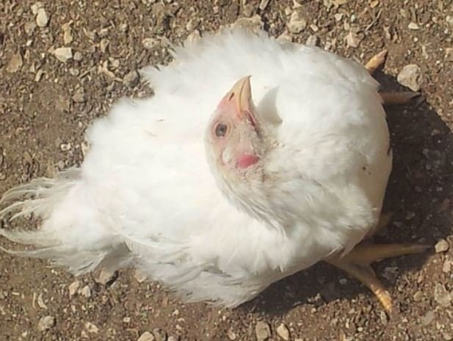
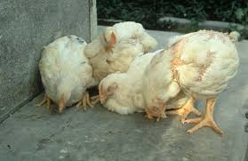
Misshapen eggs
The Birds appear depressed and lethargic with ruffled feathers and torticollis.

Slide 5
petechial Hemorrhage on the tips of glands in the proventriculus

Slide 6
(Peyer’s patches)
hemorrhage of Peyer’s patches
(typical of the virulent form of ND)

Slide 7
hemorrhage of the cecal tonsils

Slide 8
* hemorrhage in Peyer’s patches(white arrow),
hemorrhages in the proventriculus (black arrow)
typical of the virulent form of ND

Slide 9
Differential Diagnosis
Infectious bronchitis - respiratory
Laryngotracheitis - respiratory
Avian encephalomyelitis - neurological
Vitamin E & selenium deficiency - neurological
Mycotic encephalitis - neurological
Avian influenza - variable pathogenicity

Slide 10
Avian Influenza (AI)

Slide 11
Avian Influenza
Avian influenza (AI) is a viral disease characterized by
-respiratory signs.
-depression and reduced feed and water intake.
-decline in egg production.

Slide 12
Avian Influenza classified into two categories
1- Low pathogenic (LPAI) that typically causes little or no clinical signs in birds.
2- Highly pathogenic (HPAI) that can cause severe clinical signs and high mortality rates approach 90-100%.
H5 , H7

Slide 13
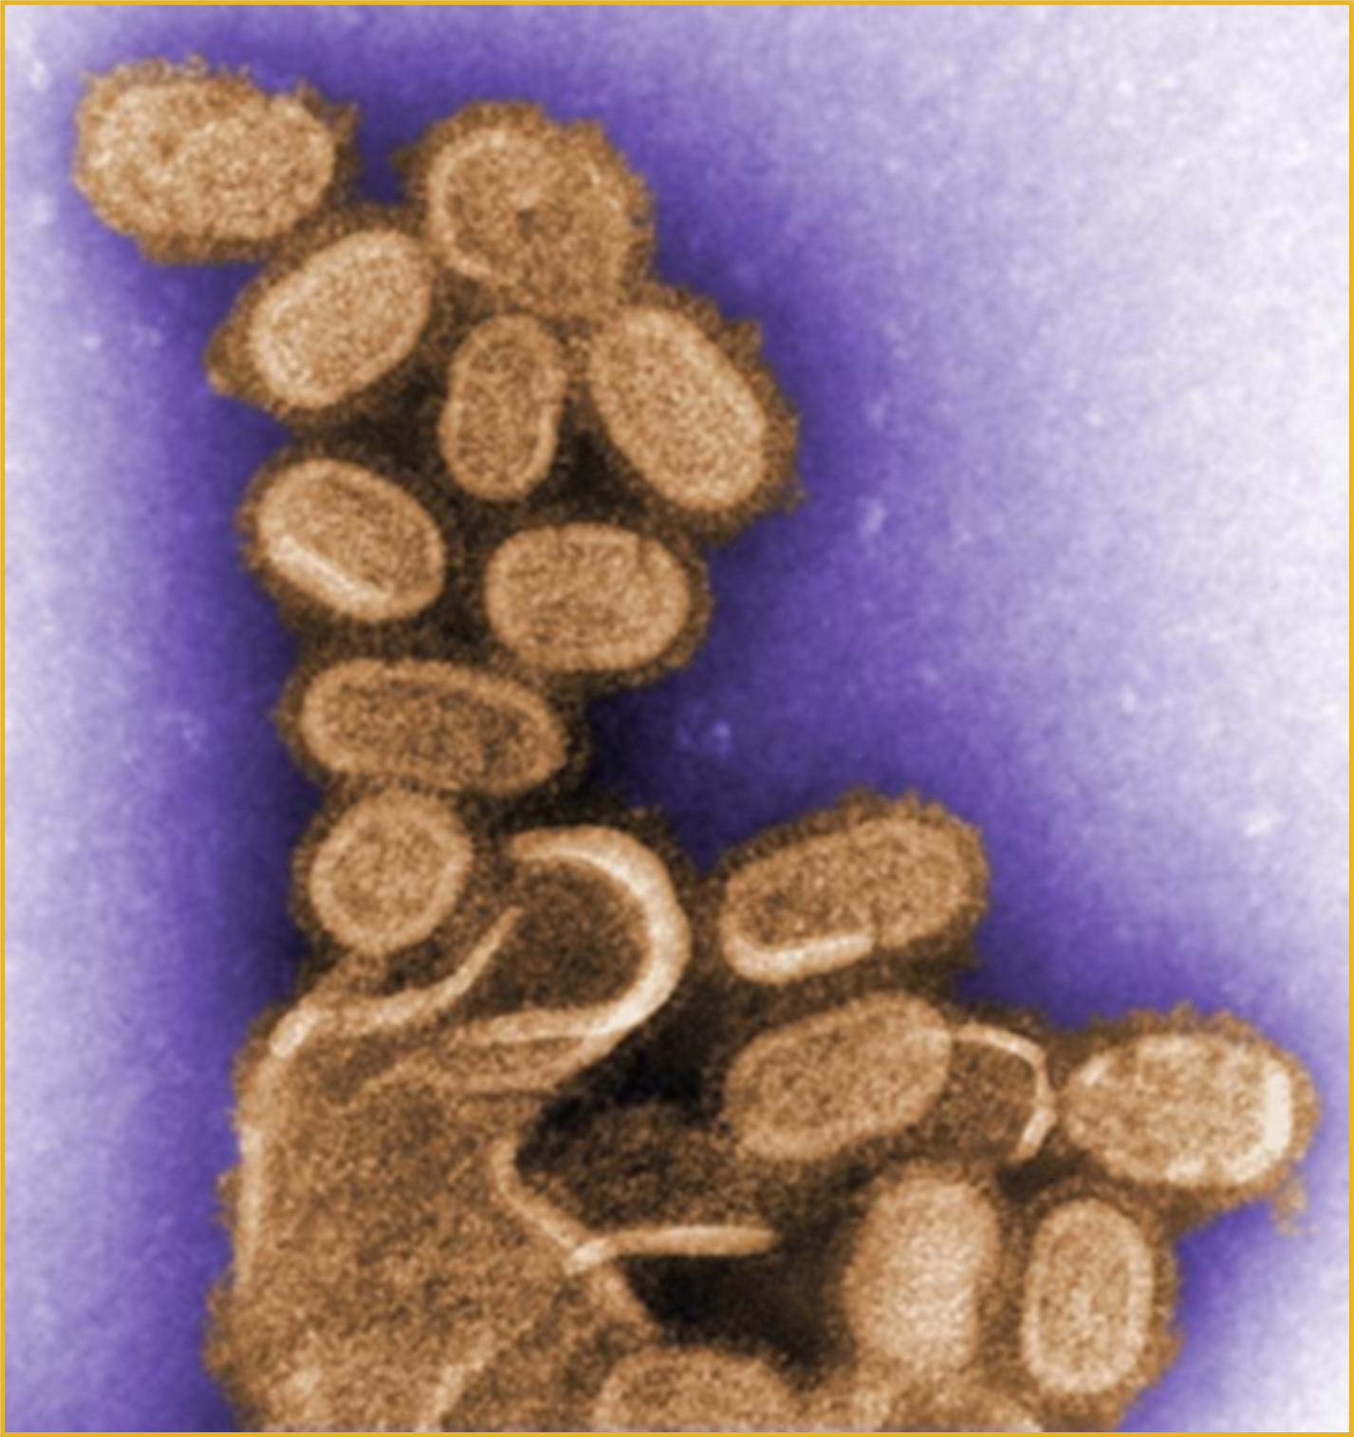
Etiology
Avian influenza virus Orthomyxovirus
surface antigens
Hemagglutinin (H)
Neuraminidase(N)

Slide 14
Avian influenza virus
Transmission in Poultry
  Fecal-oral
  Aerosol
  Mechanical vectors
  Migratory birds
  Infected poultry, pet birds
  - Incubation period
  Poultry: 1-7 days

Slide 15
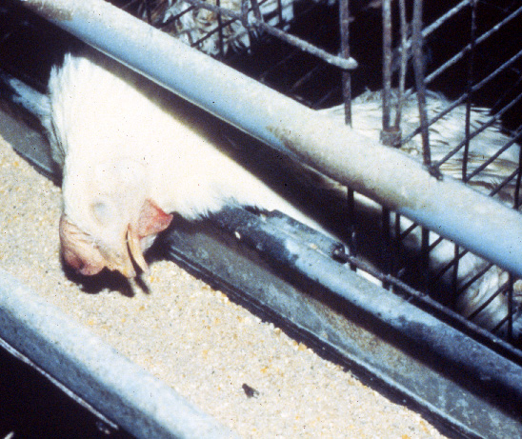
Sudden Death

Slide 16
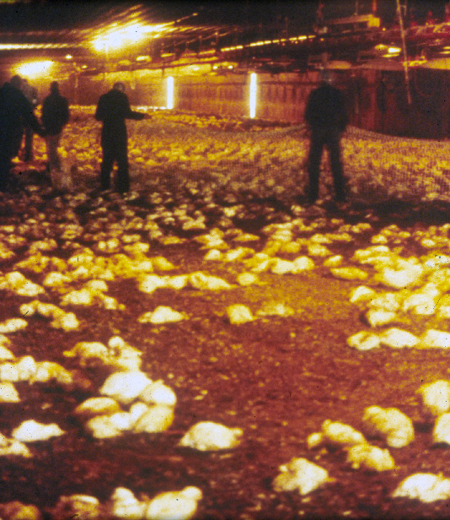
  High Mortality 90-100%

Slide 17
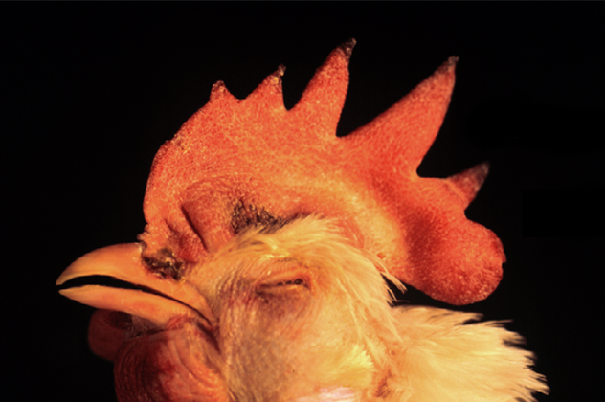
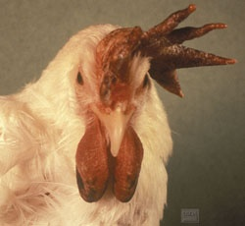
  Combs and wattle swollen, cyanotic

Slide 18
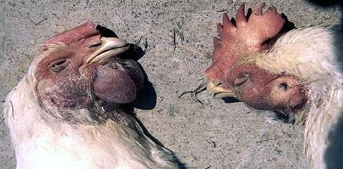
  Combs and wattle swollen, cyanotic

Slide 19
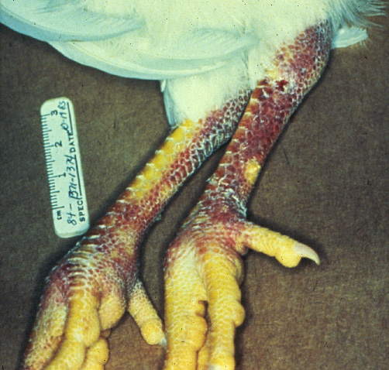
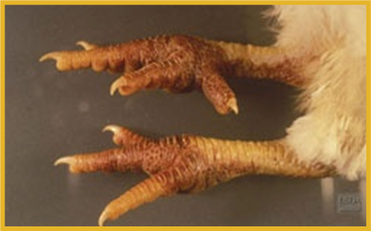
Hemorrhages or cyanosis of legs

Slide 20
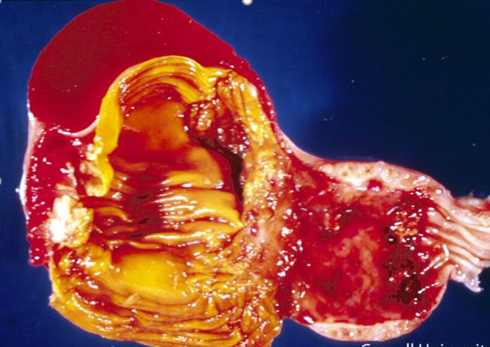
Hemorrhage in
Proventriculus

Slide 21
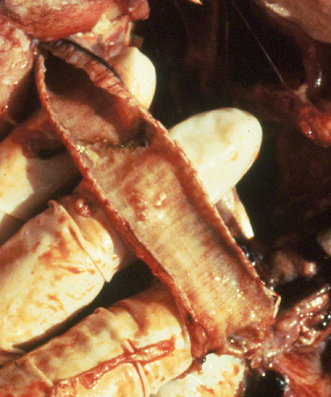
Hemorrhage in Trachea

Slide 22
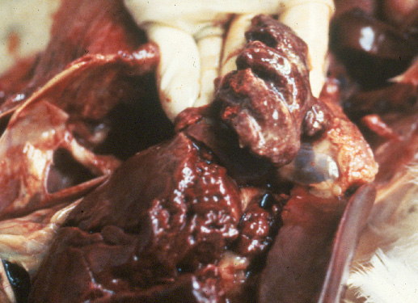
Hemorrhage in Lung

Slide 23
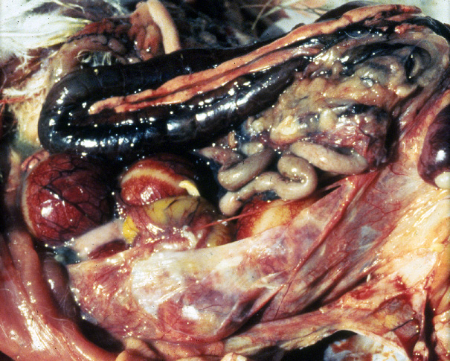
Hemorrhage in Viscera

Slide 24
Differential Diagnosis
Virulent Newcastle disease
Avian pneumovirus
Infectious laryngotracheitis
Infectious bronchitis
Chlamydia
Mycoplasma
Acute bacterial diseases
Fowl cholera, E. coli infection

